Slide 1
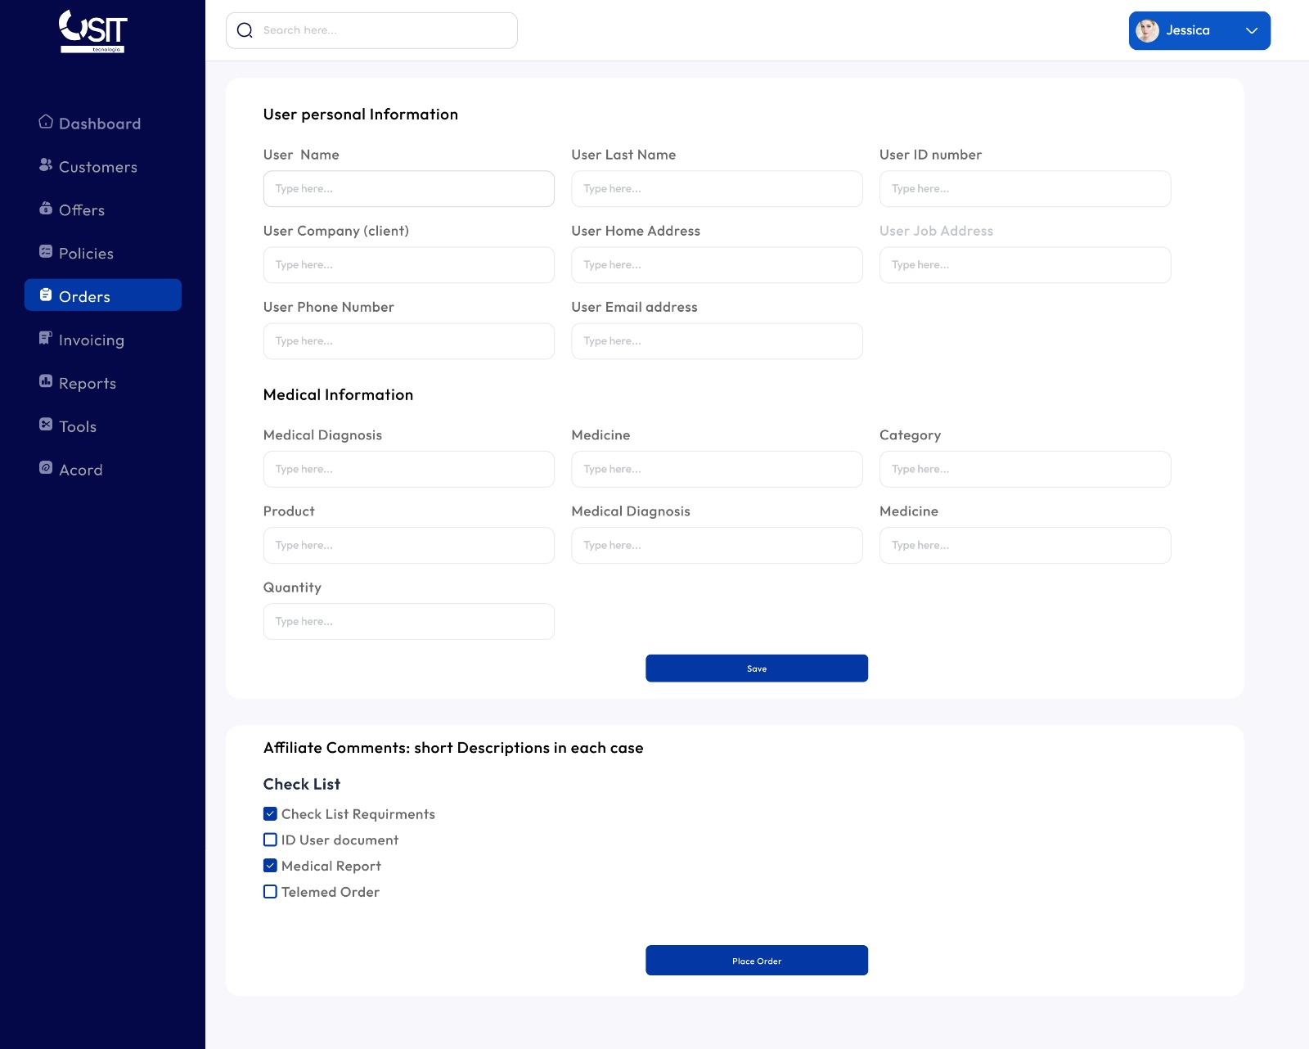


Form User Place Order
Menu
Save Process
Save Process
Place Order

Slide 2
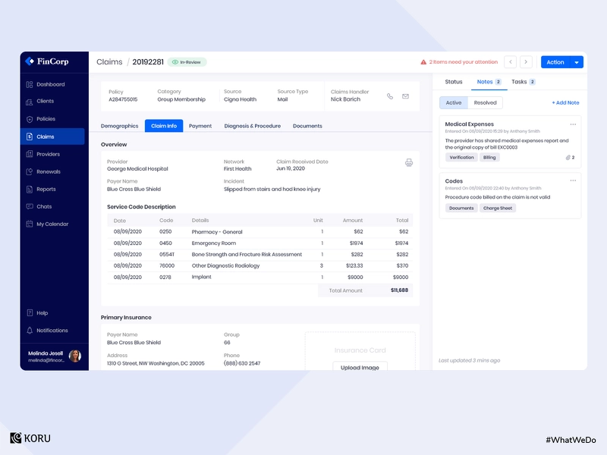

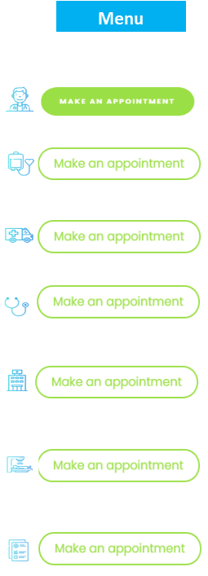
Form Review Order
Order ID
Date Order Placed
Back Analist
Medical Consultant
Pharmacy
Employee Name
Employee Id Number
Medical Diagnosis on Order
Employee Comments
Fever
Company Name
Order Descriptions
Products ID
Products Name
Paracetamol
Medicine 1
Medicine 2
Medicine 3
Medicine 4
Employee Informations
Employee Email
Employee Age
Employee Age

Slide 3
Order Details
Company Id
Order Status
Order Supplier
Farmarket
Printable Order Report
Employee Informations
Pharmacy informationswww.xxx.com
Phone:
Email
Employee Email
Employee Age
Employee SIng
Employee Age

Slide 4

Order ID
Date Order Processed
Company Id
Order Service
Company Name
Employee Name
Employee Number ID
Employee Name
Employee Id Number
Medical Diagnosis on Order
Employee Comments
Feber
Company Name
Medical Diagnosis
on Order
Red LLC
Order Type by Category
Products ID
Products Name
Paracetamol
Medicine 1
Order Status
Medicine 2
Total Amount Order
Medicine 3
Medicine 4

Slide 5
Form Medical Aproval Order – Pharmacy Model
Order ID
Date Order Placed
Back Analist
Medical Consultant
Pharmacy
Employee Name
Employee Id Number
Medical Diagnosis on Order
Company Name
Fever
Employee Comments
Order Descriptions
Products ID
Products Name
Paracetamol
Medicine 1
Authorizations Bottom
Medicine 2
Medicine 3
Medicine 4
Medical Staff Notes area
Order Status Historical Record by Dates
Employee Informations
Employee Email
Employee Age
Employee Age

Slide 6
Form Medical Aproval Order – Ambulance Model
Order ID
Date Order Placed
Back Analist
Medical Consultant
Ambulance
Employee Name
Employee Id Number
Medical Diagnosis on Order
Company Name
Fever
Employee Comments
Order Descriptions
Products ID
Products Name
Ambulance
Medicine 1
Authorizations Bottom
Medicine 2
Medicine 3
Medicine 4
Medical Staff Notes area
Order Status Historical Record by Dates
Employee Informations
Employee Email
Employee Age
Employee Age

Slide 7
Form Medical Aproval Order – Ambulance Model
Order ID
Date Order Placed
Back Analist
Medical Consultant
Ambulance
Employee Name
Employee Id Number
Medical Diagnosis on Order
Company Name
Fever
Employee Comments
Order Descriptions
Products ID
Products Name
Telemdicne – General Consultation
Telemdicne – Cardiology
Medicine 2
Authorizations Bottom
Medicine 3
Medicine 4
Medical Staff Notes area
Order Status Historical Record by Dates
Employee Informations
Employee Email
Employee Age
Employee Age

